Slide 1

PRESENTING YOU

Slide 2
INVESTINSIGHT

Slide 3





OUR TEAM - CODEBREAKERS
INVESTINSIGHT
STEVE S.
(Instructor / Client)
Chetan Patil
(Backend Developer)
Sargundeep Sachdeo
(Backend & UI Developer)
Vishal Menon
(Frontend Developer)
Shreya Kacholia
(Backend Developer)

Slide 4

PROBLEM STATEMENT
In today's rapidly evolving financial landscape, individuals need advanced tools to effectively manage their investments. The key challenge is to develop an intuitive and dynamic Financial Portfolio Manager that enables users to effortlessly monitor their stock holdings, make informed investment decisions, and track real-time market movements. Our problem statement, therefore, focuses on creating a highly engaging Financial Portfolio Manager.
USER STORIES
The user stories included
Allow the user to view a comprehensive list of all currently owned stocks.
Provide the user with detailed information on a selected stock.
Enable the user to execute buy and sell transactions for individual stocks.
Display the user's profit or loss for a specific point in time.

Slide 5




TARGET USERS
Financial Advisors
Retail Investors
Users
Beginner Investor
Experienced Investors
Subtitles: Following are the target users for our application which includes Retail Investors, Financial Advisors, Beginner Investors, Experienced Investors

Slide 6






TECH STACK
Frontend
Backend
Database
Project Management
Subtitles: The above techstack was used for developing the application. Progress amongst team was monitored by Jira & Bitbucket

Slide 7




FEATURES
BUY
Real Time Analysis
Portfolio Management
Stocks Trading
Transaction History
SELL

Slide 8

DEMO

Slide 9
SWOT ANALYSIS
WEAKENESS
THREATS
Limited investment options
Potential for cybersecurity concerns
Competition
Regularization and Govt Policies
STRENGTHS
OPPORTUNITIES
Integration with Yahoo Finance API
Comprehensive transaction history
Real Time Analysis
Stocks Trading
Growing demand
Potential to expand the platform's offerings to include other types of investments

Slide 10
FUTURE ENHANCEMENTS
Multiple Users
Risk Management
Financial Item Recommendation & Stock Price Forecast
Algorithmic Functions

Slide 11
OUR ROADMAP
04
Backend Frontend Integration
Backend API Development and Frontend UI Design
03
02
Database Formation and Project Initialisation
01
Project Kickoff and Initial Discussions

Slide 12
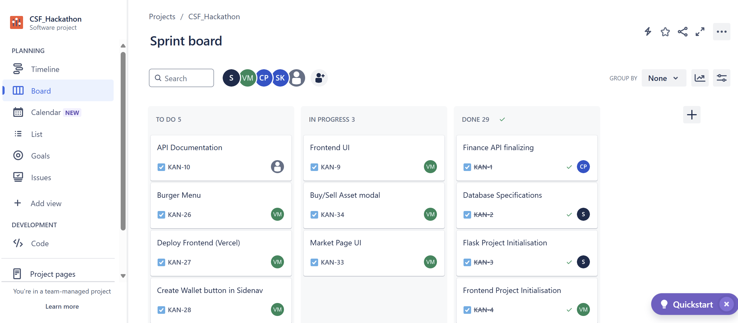
JIRA SPRINT BOARD

Slide 13
“
THANK YOU
“

